Slide 1
YELP
Phase I - Exploratory Data Analysis
Notes:
Simple 2 line introduction of self

Slide 2




Business Listings
Tools Used
Notes:
Talk About 2 parts of the ppt and 2 datasets Business and the reviews , Business gets reviews as business comes first let's begin with that.

Slide 3
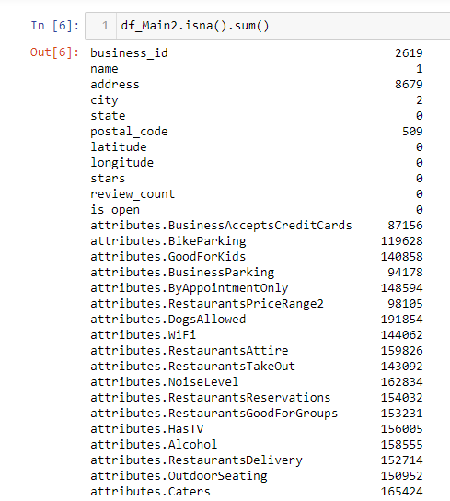
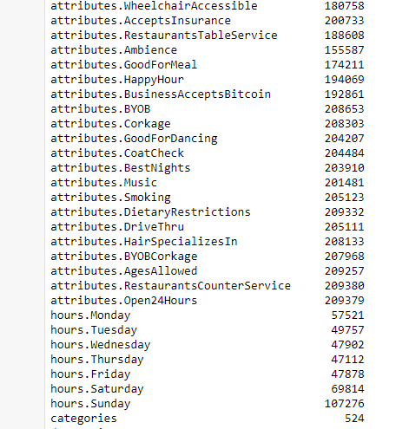
Notes:
Identify the unique businesses under analysis
Mention the missing chunk and the justify focus of the EDA

Slide 4
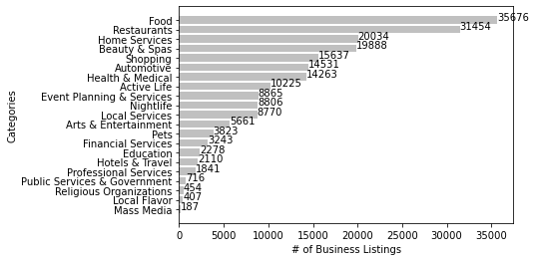
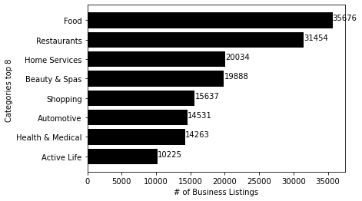
Understanding Categories

Slide 5
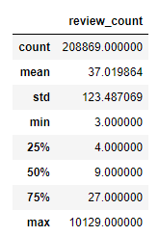
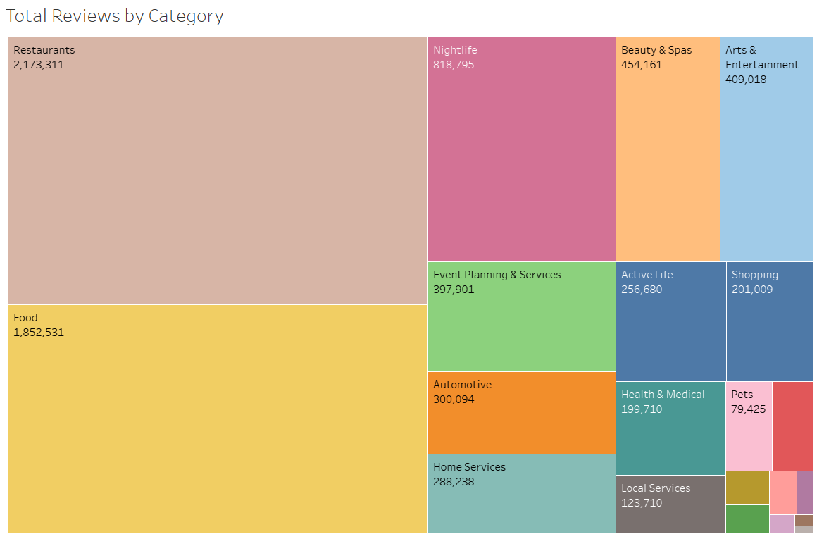
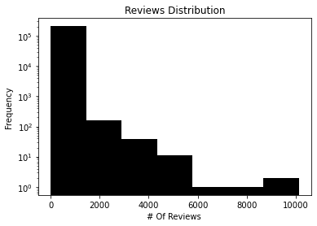
Understanding Review Counts
That’s A lot!!

Slide 6
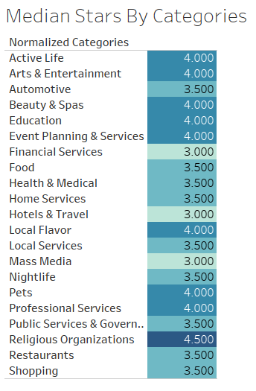
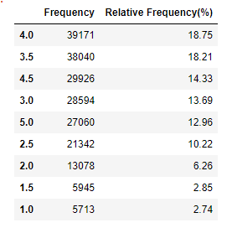
Understanding Listing Stars
Quite Religious!!

Slide 7
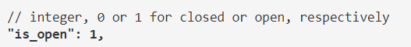
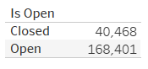
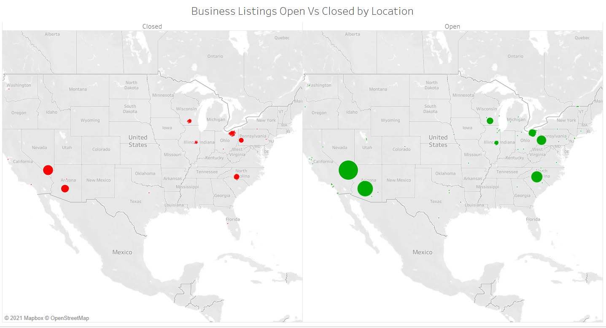
Understanding The Location
From Source Website
Approx. 20% of the total listings closed?

Slide 8

Reviews
Tools Used
Notes:
Talk About 2 parts of the ppt and 2 datasets Business and the reviews , Business gets reviews as business comes first let's begin with that.

Slide 9
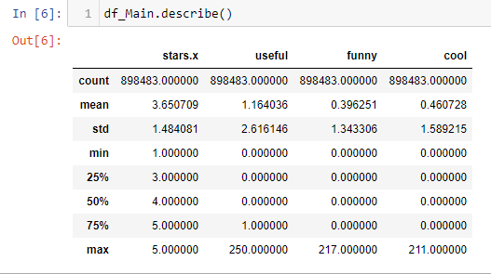
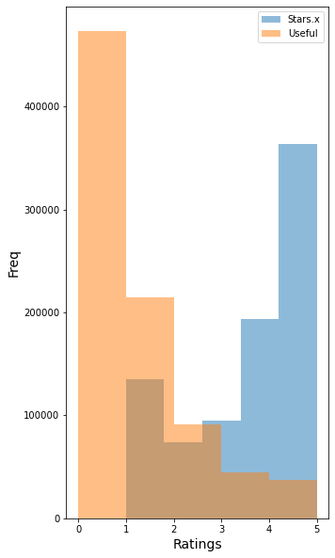
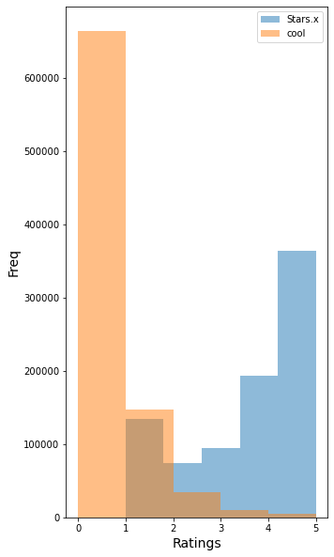
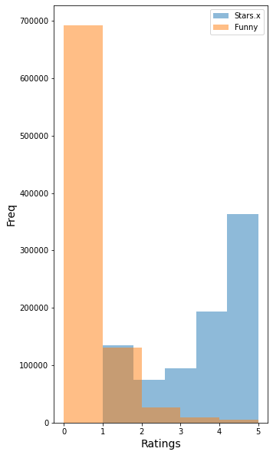
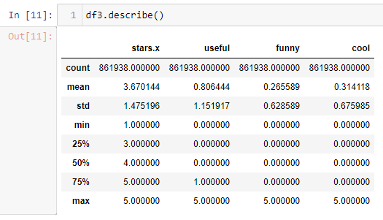
What is the deal with Stars.x, Useful, Funny & Cool ?
Summary before outliers
Star & Useful
Star & Cool
Star & Funny
Max Overlap!
Summary after outliers
4% of the reviews were filtered out to get rid of the potential outliers.

Slide 10
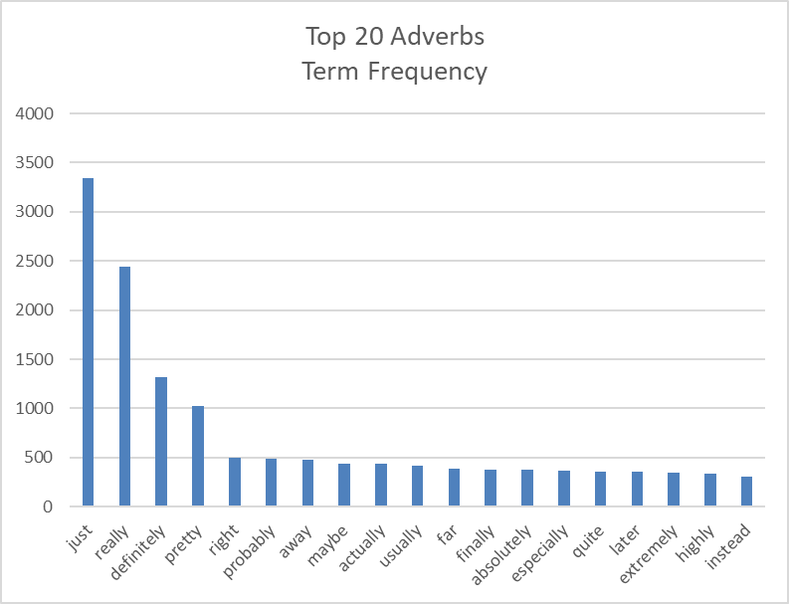
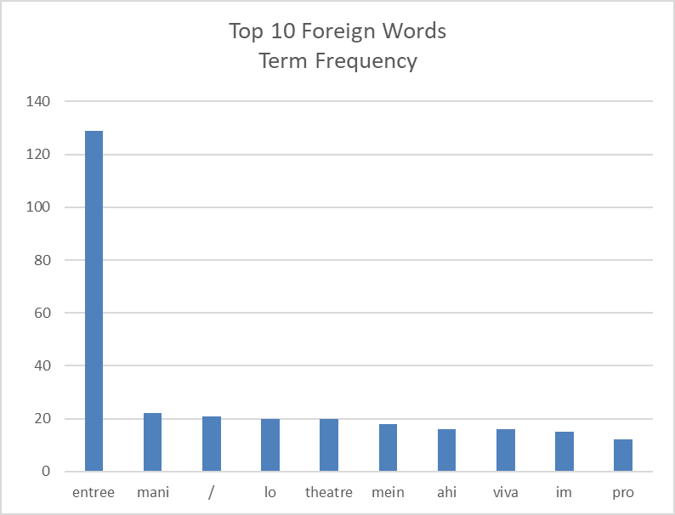
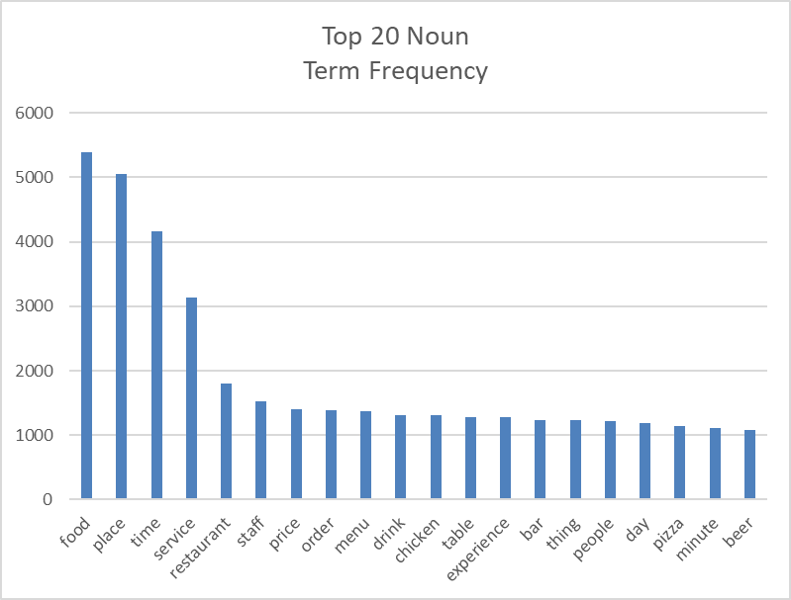
*Sneak Peak into the Consumer Reviews!
KH coder is used for text mining and qualitative analysis
French
*For review text exploration and description, a random sample of 10000 reviews was generated due to computational inability to process the text.
Spanish

Slide 11
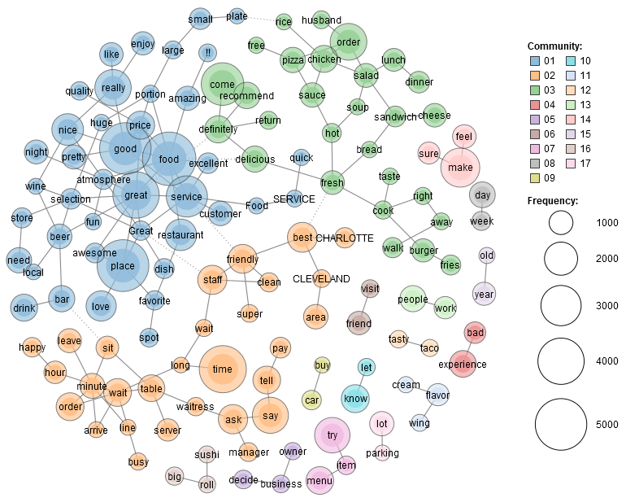
Word Association Map!
Few Speculations
Old + Year
Real estate related?
Cleveland
Definitely one of the most famous areas for delicious food
Car + Buy
Someone just reviewed a car dealership?
Lot+ Parking
GIVE US SPACE!
v
v
v

Slide 12
Potential Hypothesis
Aggregation of the business listings based upon the category(sector) of listing will generate unique review and star rating patterns.
Analyzing these patterns can be cross referenced to the timeframes of the reviews for detailed analysis.
Based on multifaceted analysis of the reviews and business categories (sector) we might figure out relationships and a way to predict review rating and overall business rating based on the features of the listing.
A “Virtual Yelp Recommender” suggesting such changes to the businesses while they list their businesses to possibly attract more consumers and more business.

Slide 13

YELP
Phase II – Advanced Analytics And Data Modelling
Notes:
Addressing the business problem i.e. the inability to keep the reviews on the platform relevant and have the necessary business intelligence across most of the
Industry sectors. I have undertaken a text analysis and sentiment prediction approach for this part.

Slide 14
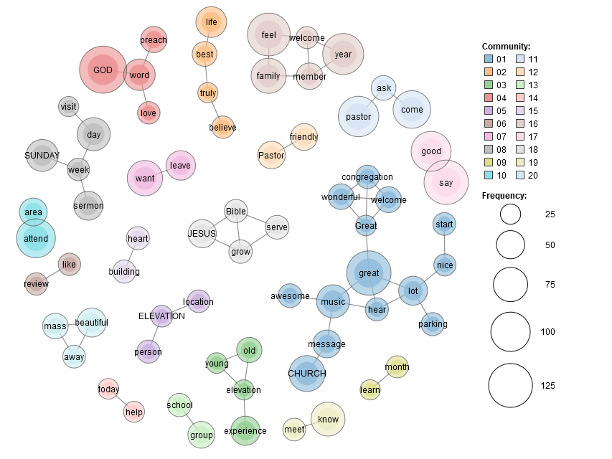
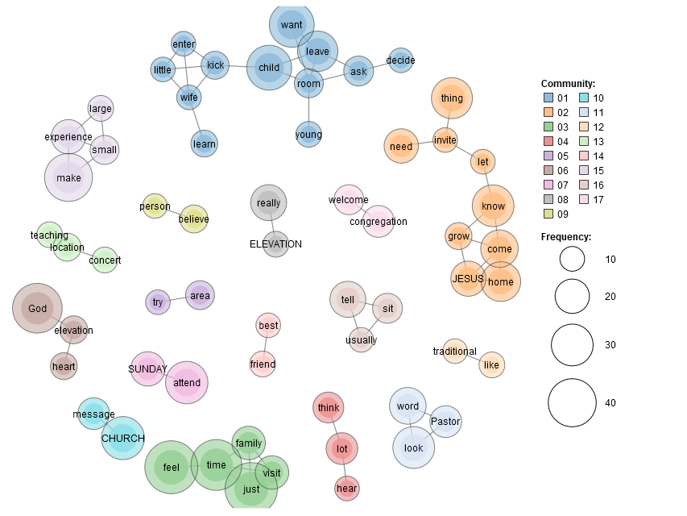

Religious Organizations All Reviews
Religious Organizations Useful Reviews
Hypothesis:
The review text has certain themes that build user perception towards the review and as a result of which a review gets useful, funny or cool scores.
Building over that we can extract such themes from the review text and use the themes to determine the near-real sentiments of the reviewers.
Notes:
Speaking of the hypothesis , When a user posts a review the user is feeling certain things so does the reader of the reviews , now does the feeling or sentiment generated by the review in the reader due to certain themes or keywords or topics present in the review? Here we have a word association map which is basically modelling co-occurrence of multiple words, here we have such a map for all the reviews from the religious organisations on the left and reviews with more than 5 useful scores on the right we can observe the Welcome_Congregation keywords that are not so common in the other expected associations such as Church_Message or Sunday_Attend, we can hence speculate that such presesce of topics drives how users perceive the reviews.

Slide 15
Approach
Clean the data and select a sample of restaurants reviews
Explore the textual data using word cloud, review polarity and subjectivity
Analyze n-grams and understand various topics
Perform topic modelling using Latent Dirichlet Allocation(LDA)
Once the model is built use the model to find probabilistic distribution of these topics in each review
Extract the distribution features along with engineered features such as review count(for the business) and review length
Generate a target variable for sentiment based on the review ratings
Train A sentiment classification model using the LDA feature matrix ,Test the model and evaluate the results
Notes:
I have selected restaurants as a category to work on due to high volume and diversity present, I have summarized my further work in this slide due to the time limitations and I will walk through the main parts of it in coming slides. To iterate the steps taken
In review data modelling…

Slide 16
Is there something driving how other people consider the review?
Approach:
Demonstrate the existence of various themes/topics being present in the review text through qualitative Exploratory Analysis, N-Gram Modelling and Latent Dirichlet Allocation(LDA) modelling to validate the hypothesis.
Using these themes(LDA) to extract probabilistic distribution of themes in individual reviews and use the distribution as an input and use the intelligence to build a sentiment classifier along with engineered features.
Notes:
Hello all the viewers the question I am trying to address is , whether there are any driving factors that influence the users perception of the reviews.
To achieve a solution and aid Yelp and the business listings with such intelligence I have taken a qualitative data analysis approach and performed Latent Dirichlet Allocation modelling
Which is fancy words for text clustering and used the topics present to build a sentiment classifier. This is a summary of my work and I will skip technical details due to time limitaions.

Slide 17
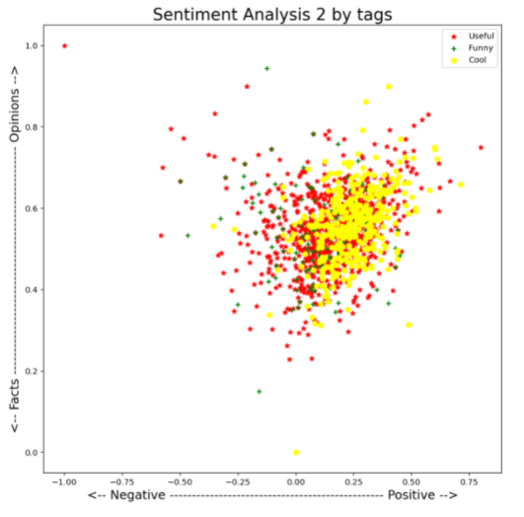
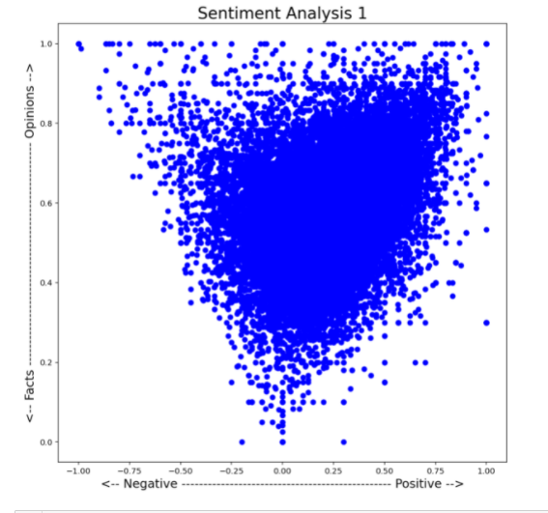
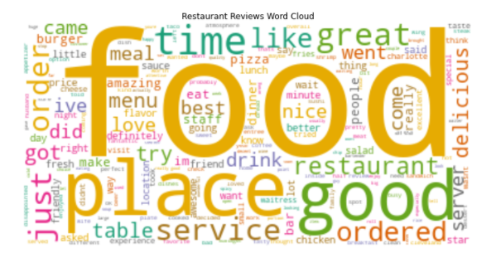
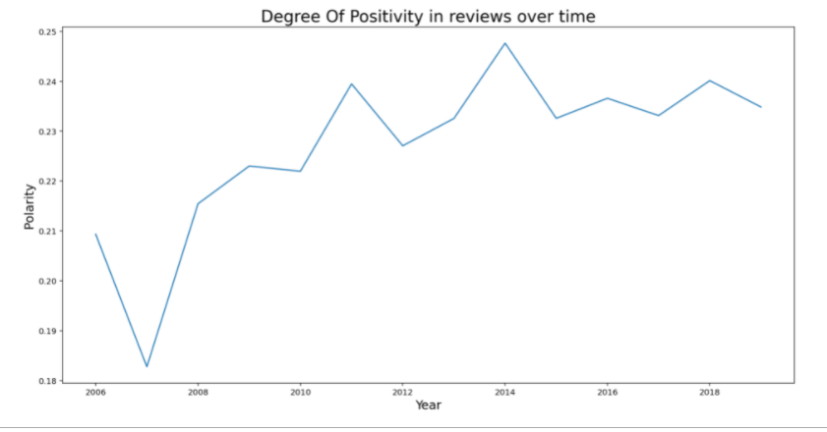
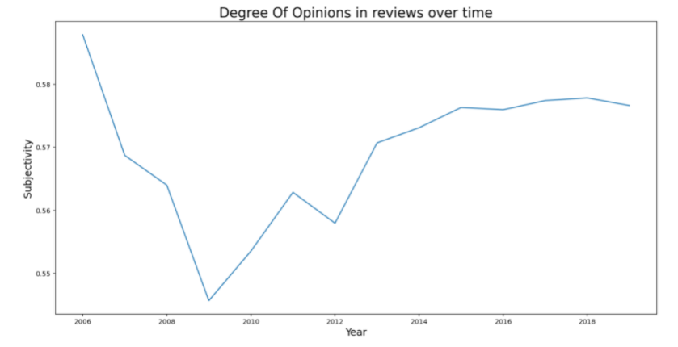
Advanced Exploratory
Analysis
High density!
Steep Drop
Gradual Increase in Positivity
Notes:
As we can observe in the word cloud the major theme of the reviews is food the place, good and time. Using textblob we perform polarity and subjectivity analysis asto
Understand the opinionated and factual vs the positive and negative reviews , it is interesting to see that the most of the reviewers are highly opinionated as well as positive.
Going further we tag the reviews as useful funny and cool and there are more number of useful and cool reviews and even though these reviews are subjective they have positive rating
And are highly opinionated, it is quite evident from this that opinions is what people seek .
As an experiment we plot the average polarity and subjectivity over time we can see that there is a steady growth in the positivity of the reviews over the time
On the other hand something interesting happened In year 2009 as the scalar magnitude of the drop is less it is quite visible and observes a steady growth in opinionated
Perception over time may be that is why most reviews are positive in sentiment as well.

Slide 18
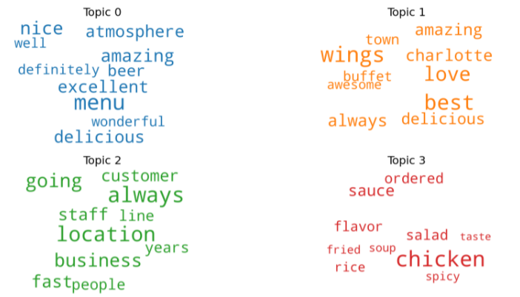
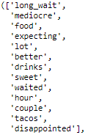
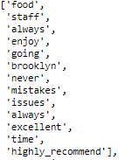
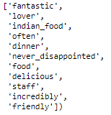
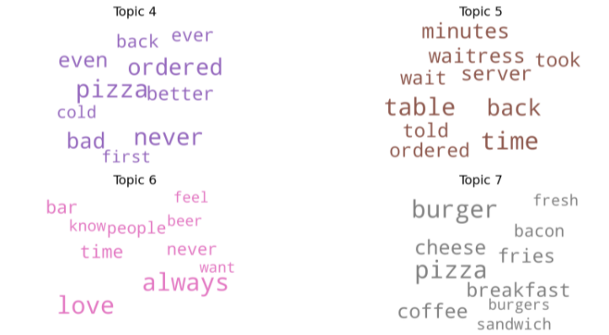
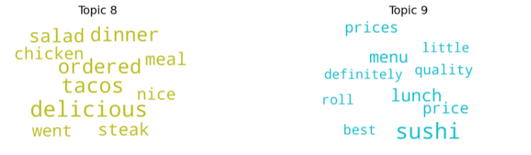
Themes?
What are they?
Bi-Grams
Latent Dirichlet Allocation
Notes:
Moving on to advanced analytics lets focus on the various themes that might be present in the reviews and for this purpose we have selected restaurant category reviews due to higher volum and better diversity. On the left we can see few Bi-gram examples and wht keywords go with such bigrams, the right most is my favorite as its true Indian _Food , Never_disappoints!!
To build on to that I have used a sophisticated LDA model to produce multiple such underlying themes being present in the reviews, another fancy description for the unsupervised learning on textual data. We can observe that there are various themes present around distinct food items. Such as Wings, Sushi Pizza Chicken, but also around service Location etc. This gives us a precursor as to what is being discussed or posted as a review.

Slide 19
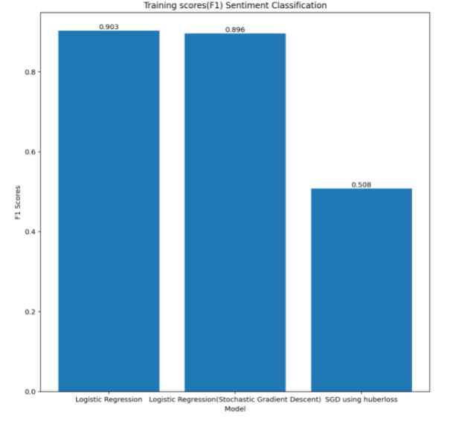
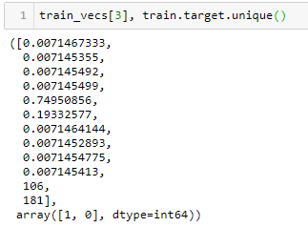
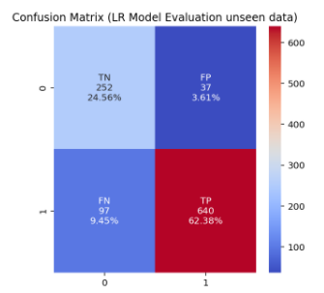
Modelling and Prediction
Data Input
Training and Validation
What a probabilistic distribution for a single review looks like?
.903
.896
Lost Cause!
.508
Notice This
Logistic Regression(SGD)
Logistic Regression
Logistic Regression(Huber Loss)
Evaluation
Notes:
Now, how do we use this information that we see in topic modelling, using unsupervised learning outcomes as features for building a predictive model for the sentiments
As essentially the sentiments are the outcome of various topics present in the reviews. Notice one reviews probabilistic distriburion for a topic being present in that review ,
We can see that 2 topics are quite evidently present and similarly different topics would be dominant in different reviews, then I trained a few classification models
And as you can see that the classification works ogistic regression is promising and though I tried using a fancy model it failed , principal of parcimony I guess.
Nonetheless we test the classifier on unseen data and the results are astonishing and.
To summarize we can understand the themese present in the reviews we can understand phrases the sentiments that are present and also predict them with finesse!

Slide 20
Recommendations
Simplicity is impactful!
Clustering segmentation intelligence for Advertisement on a shared Yelp platform.
Scaling the sentiment Analysis across industries for the sentiment prediction.
Topic Modelling Across huge volume of reviews to identify threats, bad reviews, store valuable information.
Business Success and failure analysis as a service from Yelp to Business listings.
Notes:
Now coming to the recommendations!
Relevance of website is key element for Yelp, it can stay relevant with the insights from clustering, using the intra industry segmentation as well as inter industry segmentation, Advertisement campaigns can availed to the business listings as the Yelp platform is known to generate high traffic volumes this will Generate revenue streams for Yelp and more business for the listings.
Yelp can scale the sentiment Analysis across multiple industries for the sentiment prediction. the businesses listed on the platform can focus on desired reviews sentiments. Moreover, businesses can now predict the review sentiment with statistical significance and use the volume of reviews to their benefit.
Yelp can use the information generated by N-gram modeling and Topic Modelling to identify threats , bad reviews and use such reviews as a label to improve on the website security and consumer satisfaction.
Businesses listed on the website can be notified of important features and how they will impact their reviews and ratings using correlation analysis results.`

